Slide 1
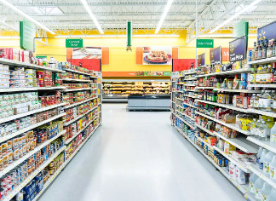
GROCERIES STORE
GROCERIES STORE
Presented By-
Vanshika jain (MABSPG23045)
AshishVats(MABSPG23009)
Jhanvi Aggarwal (MABSPG23020)
Himanshu Gupta (MABSPG230
Himanshu Kumar (MABSPG23019)
Presented By-
AshishVats(MABSPG23009)
Himanshu Gupta (MABSPG23018)
Himanshu Kumar (MABSPG23019)
Jhanvi Aggarwal (MABSPG23020)
Vanshika jain (MABSPG23045)

Slide 2
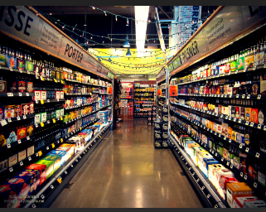
Objectives
The Objective is to explore and analyze the Groceries Dataset to gain valuable insights into the data.
The analysis is carried out using SQL queries to extract meaningful information about the dataset, which includes grocery item descriptions and associated details.

Slide 3
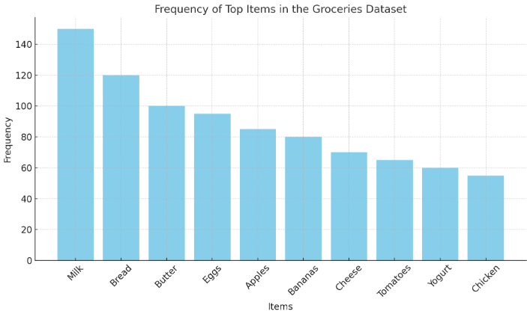
Insights
This graph represents a clear visual of which items are most frequently purchased, helping to identify popular products in the dataset.
Milk and Bread are the most frequently purchased items, with over 100 transactions each. This suggests they are staples in many customers' shopping lists.
Chicken and Yogurt are less frequent but still significant.
Record Count: Total number of grocery transactions in the dataset.
Item Statistics: Min, max, and average of itemDescription.
Item Frequency: Popular items based on occurrence in transactions.
Specific Item Search: Example, items with "milk" in the description.
Date Filtering: Trends for items after a specific date (e.g., post-2015).

Slide 4
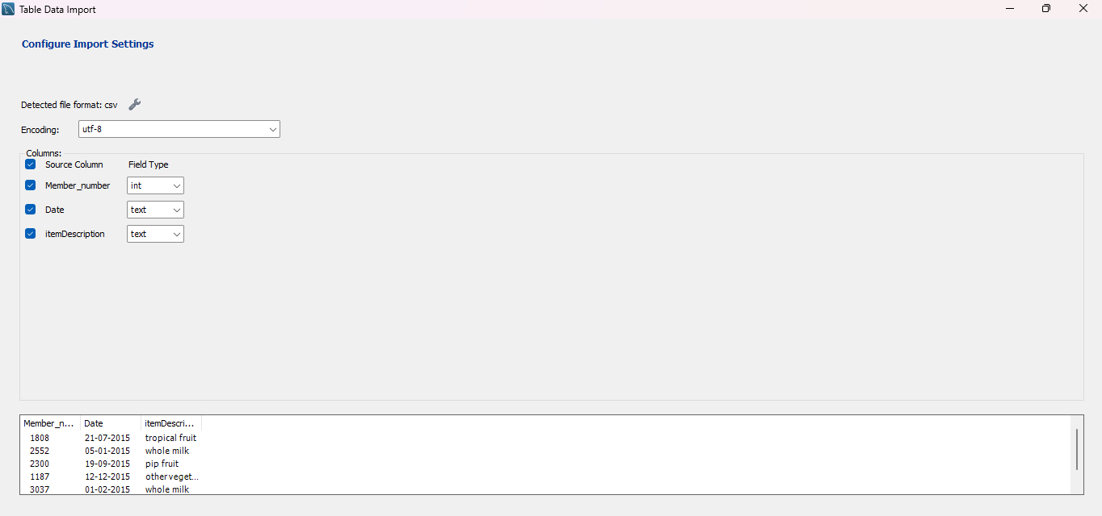
IMPORTING THE DATA
.

Slide 5
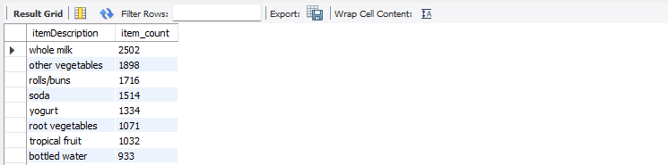
Sorting RESULT
Sort by Date (Oldest to Newest):
Sorting refer to the SQL commands used to arrange the result set of a query in a specified order based on one or more columns. Sorting allows users to present data in a more organized way, making it easier to read and analyze
. ORDER BY clause is used to control the order of results based on one or more columns, facilitating easier data interpretation and analysis.
Here is the result:

Slide 6

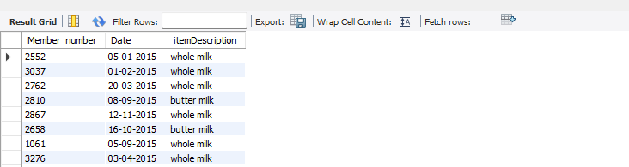
Using Logical Operators

Slide 7
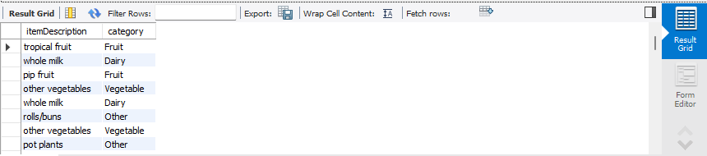
Control flow functions allow you to execute specific actions based on certain conditions or control the flow of execution within your SQL statements.These functions enable you to implement logic, handle errors, and control the flow of execution in your SQL scripts.
Here is the result of control flow function:
CONTROL FLOW FUNCTION

Slide 8
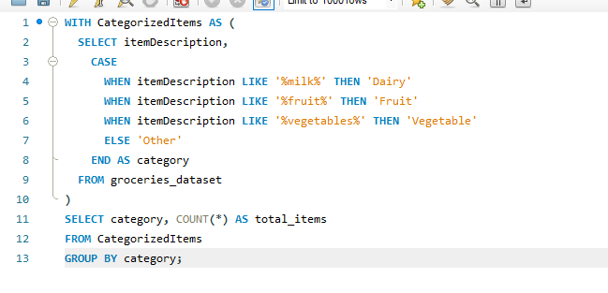
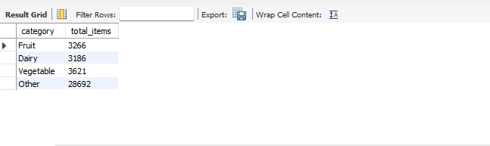
Combining Control Flow and CTEs
CTEs, or Common Table Expressions, are a temporary result set that is defined within a SELECT, INSERT, UPDATE, or DELETE statement. They can be thought of as a temporary view that is derived from a query, and can be used as a table in the FROM clause of a query.

Slide 9
Conclusion
The SQL queries performed on the Groceries Dataset demonstrate the power of data analysis in uncovering consumer behavior patterns, item popularity, and strategic insights for grocery retailers. These findings can guide decision-making processes, enhance marketing strategies, and improve inventory management to better align with customer preferences. Future analyses could further explore seasonal trends, pricing impacts, and cross-category relationships to enrich understanding of the grocery market.

Slide 10

Thank you

